Slide 1
Alpha Presentation Switch Alignment Mobile Game
Team Union Pacific
Jiayue Chai
Zack Joyce
Alexa Kelley
Kyle Martin
Mike Walton
Daniel Wylie
Department of Computer Science and Engineering
Michigan State University
Spring 2023

Slide 2
Project Overview
A game to train Union Pacific employees to identify different switch alignments.
Designed for Android and browser platforms with first-person view and realistic simulations.
Infinite runner style with scoring feature and leaderboard.
Include various challenging conditions such as nighttime and snowy weather.

Slide 3
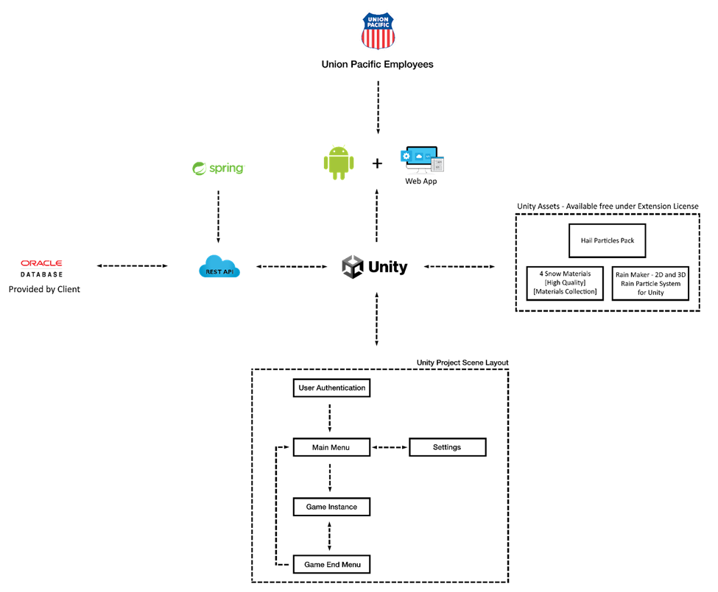
System Architecture

Slide 4
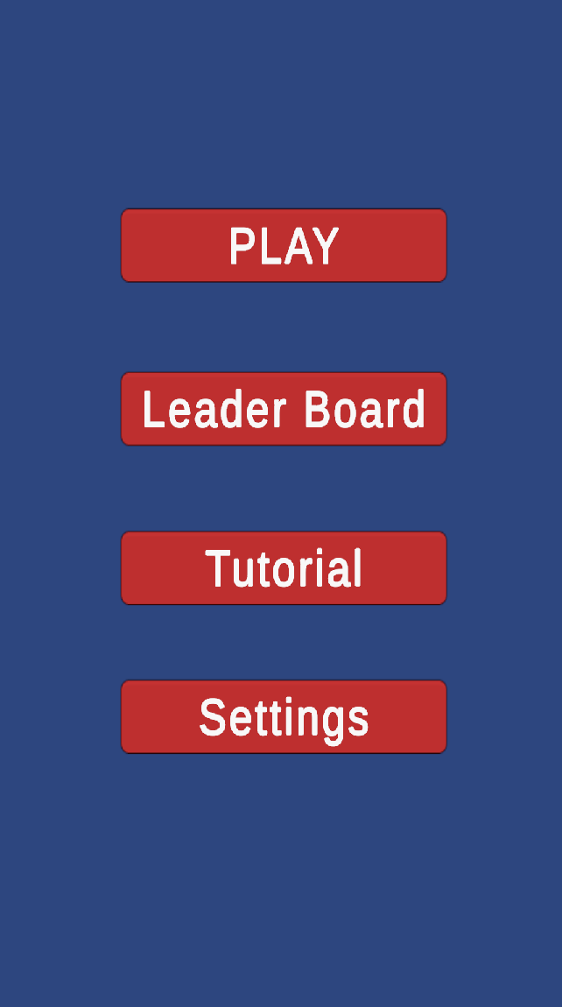
Main Menu

Slide 5
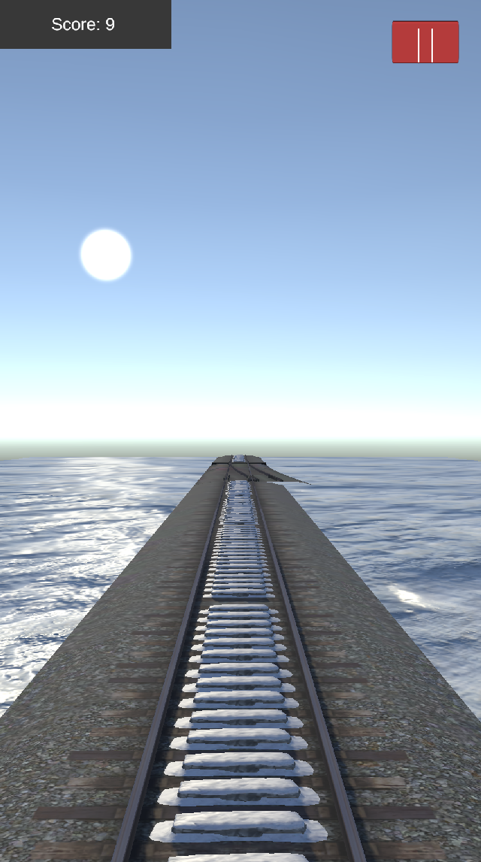
Gameplay Scene

Slide 6
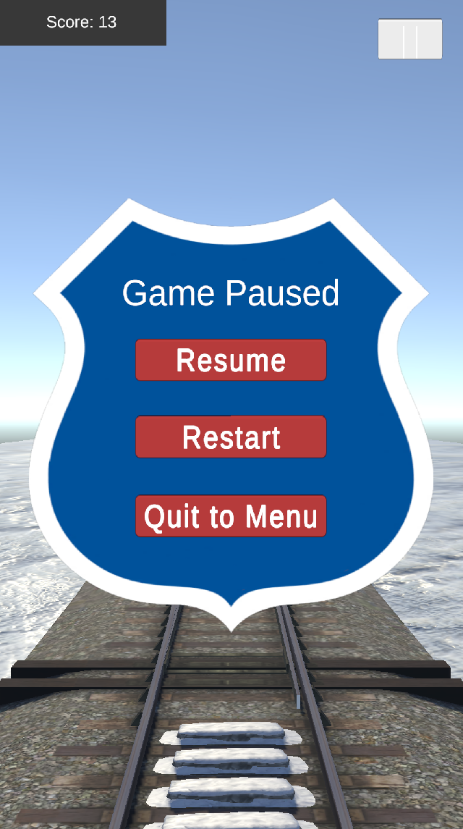
Pause Menu Scene

Slide 7
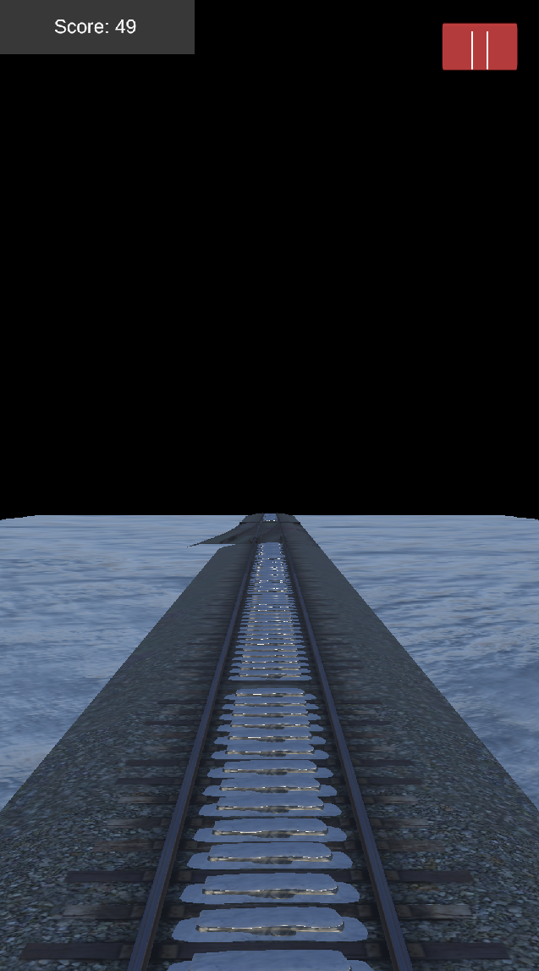
Night Gameplay Scene

Slide 8
What’s left to do?
Swipe interaction in the game.
Particle system of rain and snow.
Leaderboard and scoring.
Random weather generation.
Sloped terrain.

Slide 9
Questions?
?
?
?
?
?
?
?
?
?

